Slide 1
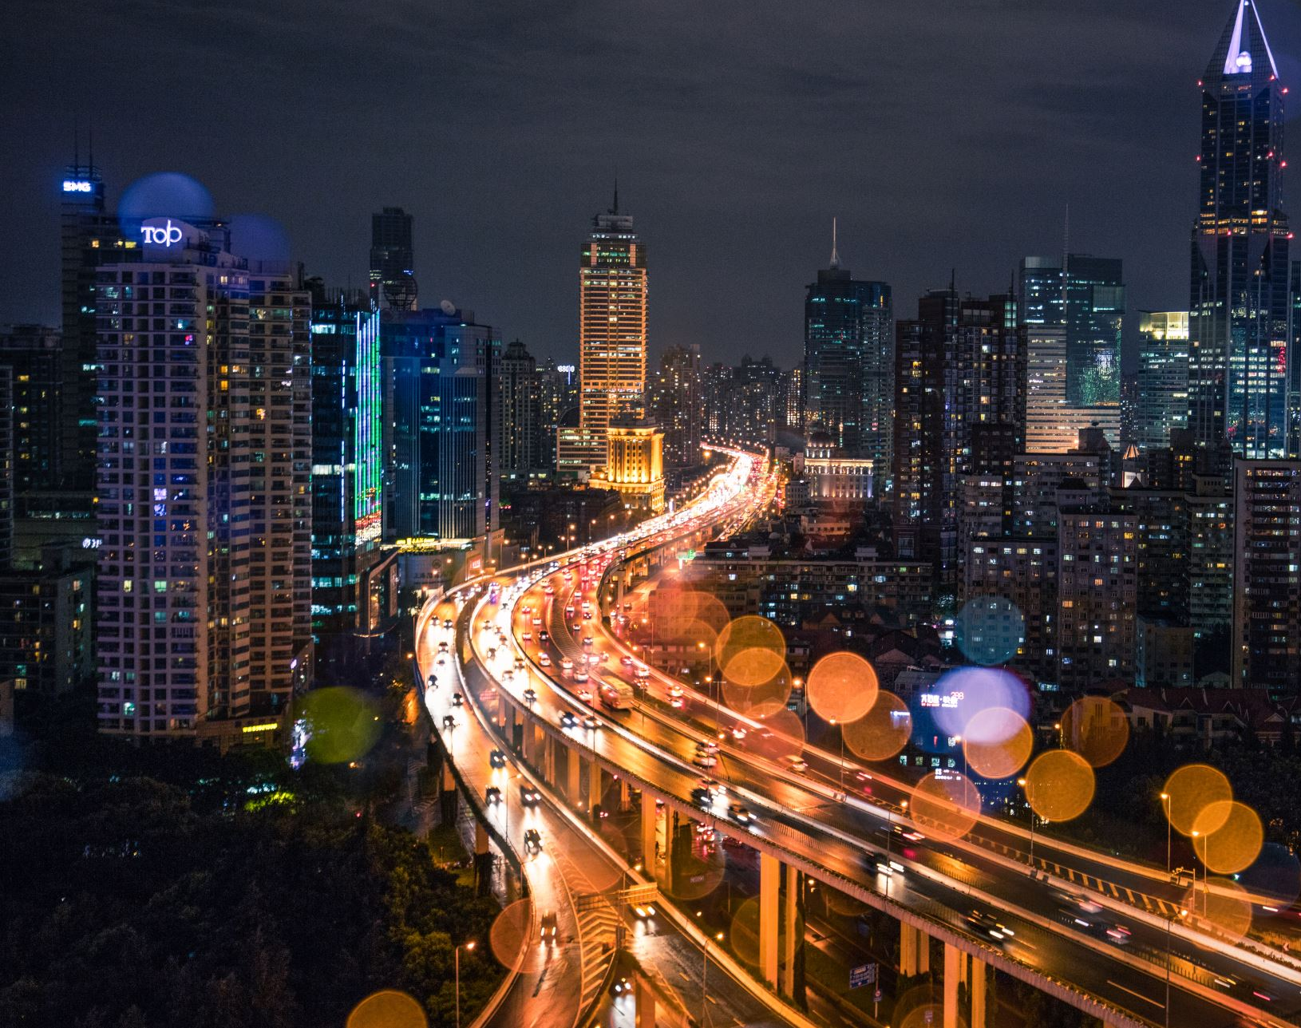
Traffic Sign Recognition System
Presented by:
Jasleen Kaur
Komal Astawala
Mayankkumar Patel
Simran
Shreeprada devaraju

Slide 2
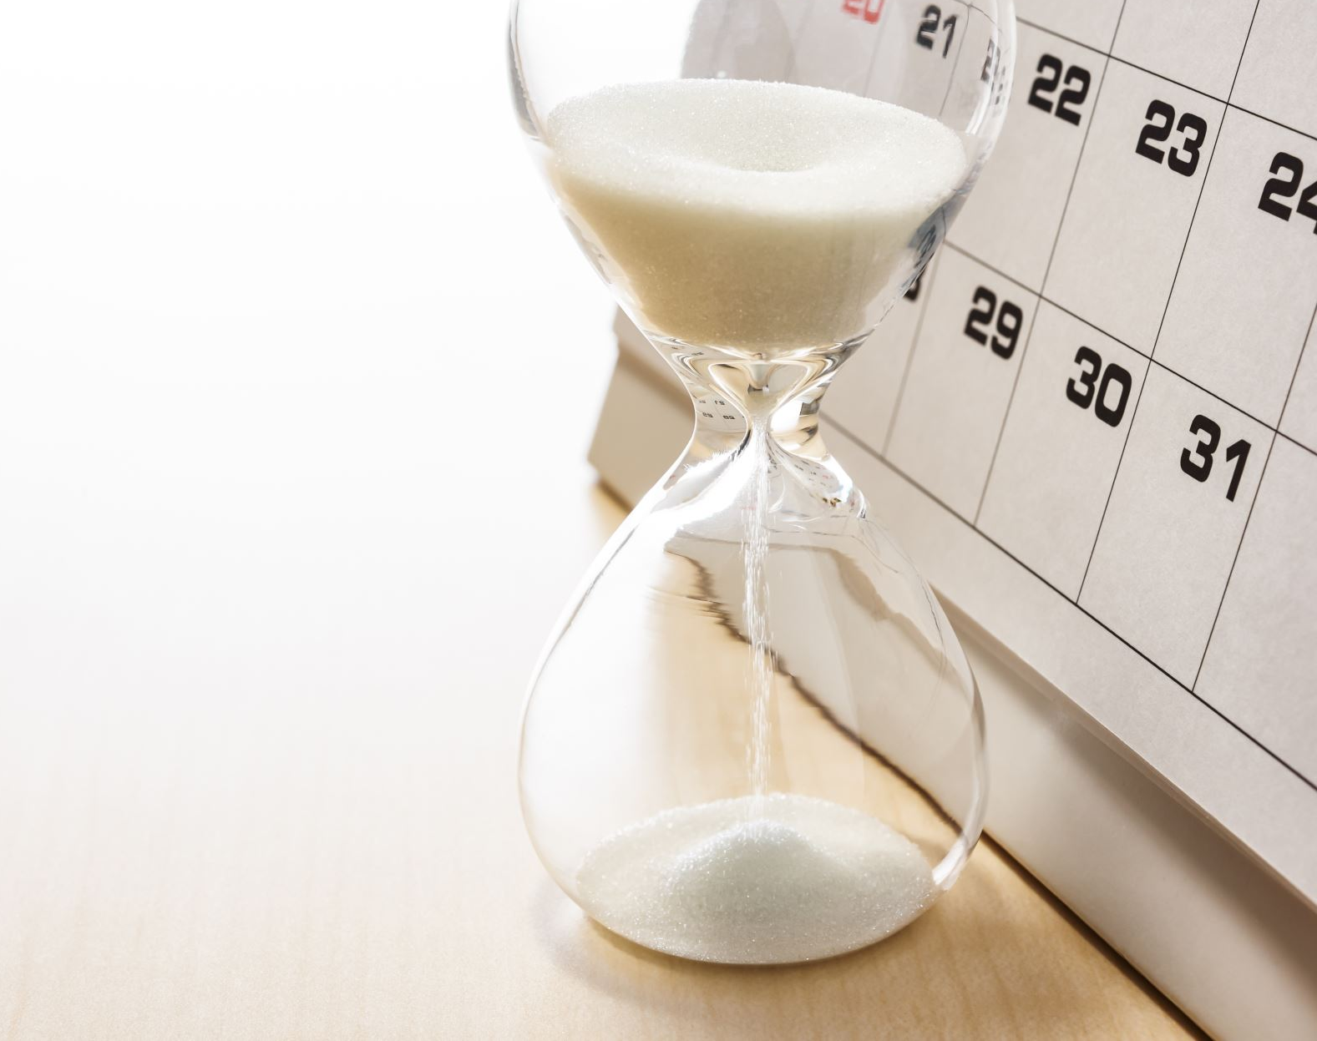
Agenda
Introduction
Introduction to Dataset
Data Pre-Processing
Model Implementation
Model Tuning
User Interface
Lessons Learnt

Slide 3
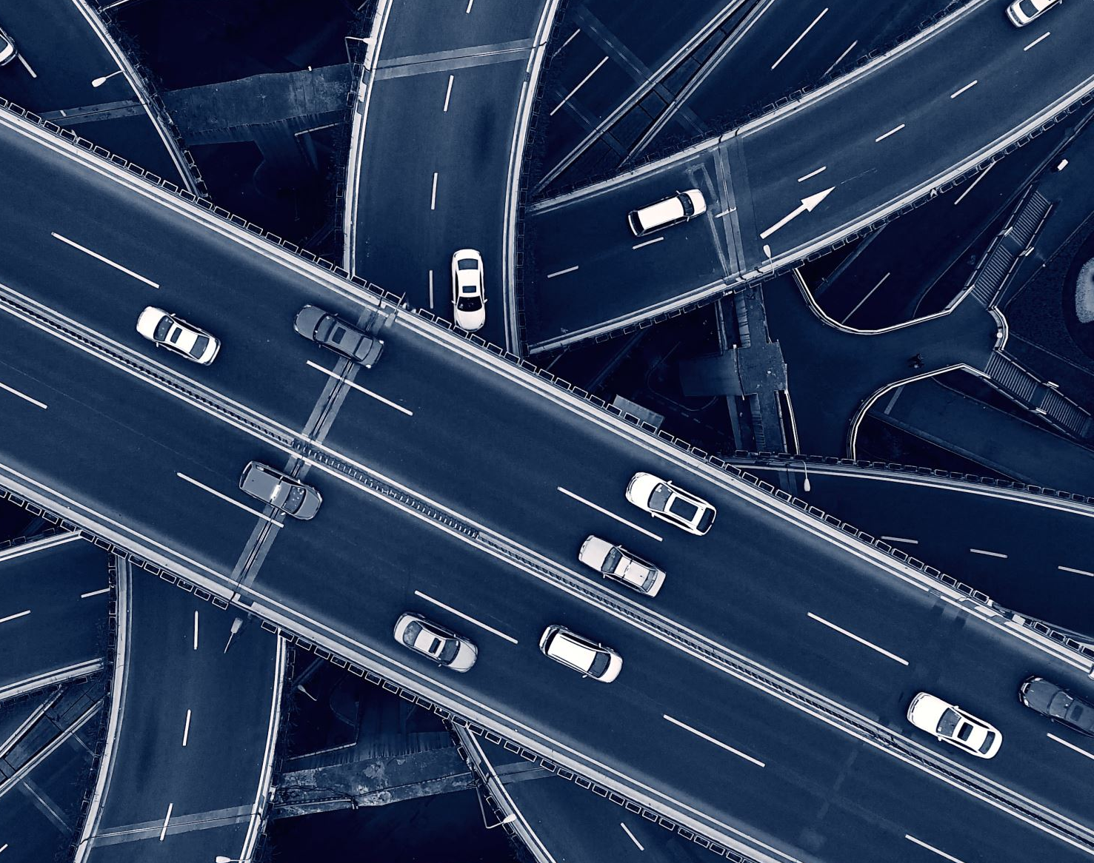
Introduction
Problem Statement:
Development of a deep learning system using Python and Keras to accurately classify traffic signs from images.
Significance:
Automation of the recognition of traffic signs, which is essential for autonomous vehicles and advanced driver-assistance systems (ADAS).

Slide 4

Dataset: German Traffic Sign Recognition Benchmark (GTSRB)
Source: Kaggle
Metadata
43 distinct classes comprise almost 50,000 photos of various traffic sign types in the dataset utilized for this study.
The collection contains images in four colors (0-red, 1-blue, 2-yellow, 3-white) and five sizes (0-triangle, 1-circle, 2-diamond, 3-hexagon, 4-inverse triangle).
Introduction to Dataset

Slide 5

Data Preprocessing
Image Count Reduction:
Raw data has 43 unbalanced folders of different images.
To create balanced dataset, every folder content size was reduced to have 500 images
For folders having less than 500 images, augmentation techniques were used

Slide 6
Data Preprocessing
Image Augmentation:
Image Rotation: Rotating an image around its center by a specified angle.
Image Flipping: Mirroring an image horizontally or vertically.
Image Translation: Shifting an image in horizontal and vertical directions.
Brightness Adjustment: Altering the brightness level of an image.
Image Shearing: Distorting an image by shifting one side relative to the other.

Slide 7
Model Implementation
Convolutional Neural Network (CNN) Architectures implemented:
VGG16
Logistic Regression
Random Forest Classifier

Slide 8
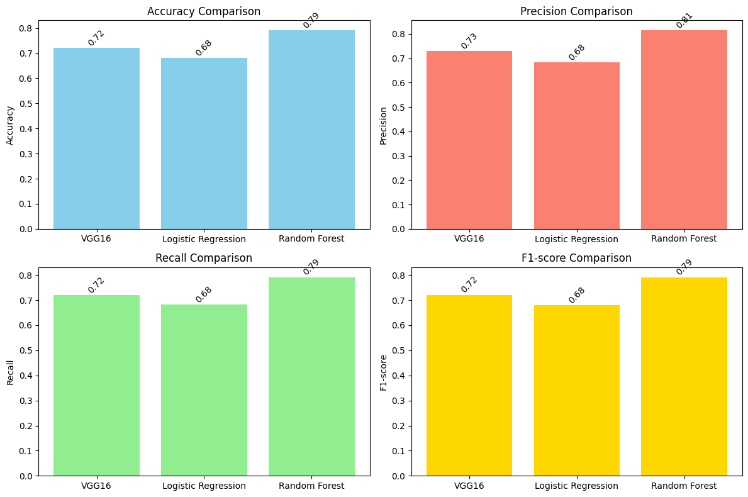
Comparison of VGG16, Logistic Regression and Random Forest Classifier

Slide 9
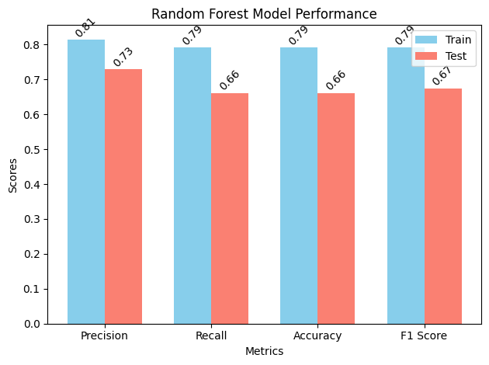
Metrics Comparison of Train and Test performances

Slide 10

Model Tuning
n_estimators=100:
The best model was found to perform optimally with 100 decision trees in the forest. This means that the model combines the predictions of 100 individual decision trees to make its final prediction, which helps in reducing overfitting and improving generalization.
max_depth=None:
The best model was found to perform optimally without limiting the maximum depth of the individual decision trees. This allows the trees to grow as deep as necessary to capture the complexity of the data, which can be beneficial for improving the model's performance on the given task.

Slide 11
User Interface
Utilized .h5 Format for Storing Trained Models :
A convenient choice for managing large models and facilitating easy sharing and deployment.
Created and Implemented GUI using Tkinter:
A standard Python library used for creating graphical user interfaces (GUIs).

Slide 12

Lessons learnt
Model Exploration: Research and experiment with different models to find the most suitable one.
Hyperparameter Tuning: Continuously adjust hyperparameters and increase epochs to optimize model performance.
Data Utilization: Use more data to enhance accuracy, while implementing strategies to prevent overfitting.
Augmentation Balance: Be cautious with data augmentation to avoid negatively affecting accuracy.

Slide 13

References
https://www.kaggle.com/datasets/meowmeowmeowmeowmeow/gtsrb-german-traffic-sign/data
https://medium.com/analytics-vidhya/data-augmentation-techniques-using-opencv-657bcb9cc30b - Image augmentation
https://towardsdatascience.com/complete-image-augmentation-in-opencv-31a6b02694f5 - Augmentation

Slide 14

THANK YOU

